Slide 1
GRADE 7 ACCELERATED · UNIT 3 · THREAD A · DAY 1
Exponent Laws with Variable Bases
MA.8.AR.1.1
I can multiply and divide monomials, and raise a monomial to a power, by applying the laws of exponents to variable bases.
Yesterday the bases were all numbers.
Today the base is a letter. Every law still works.
Grade 7 Accelerated · Unit 3 · Thread A · Day 1 — Exponent Laws with Variable Bases
1

Slide 2
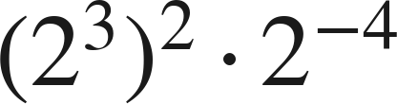
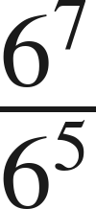


Warm-Up
On your own. Four minutes. No notes.
1. Find the value:
2. Write as one power:
3.
is between which two whole numbers?
4. Write with an exponent:
Grade 7 Accelerated · Unit 3 · Thread A · Day 1 — Exponent Laws with Variable Bases
2

Slide 3

Warm-Up
Answers.
1. Find the value:
4
2. Write as one power:
6² = 36
3.
is between which two whole numbers?
7 and 8
4. Write with an exponent:
Grade 7 Accelerated · Unit 3 · Thread A · Day 1 — Exponent Laws with Variable Bases
3

Slide 4
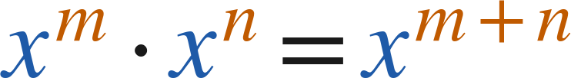
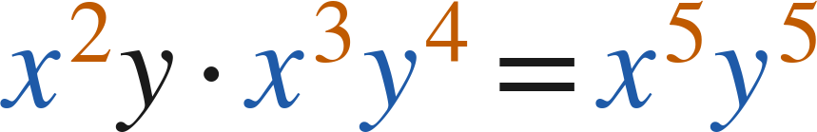
Notes
Copy both lines.
I. Product of powers — the base is a letter now
Multiply the coefficients. Add the exponents of like bases.
Different variables stay separate:
Grade 7 Accelerated · Unit 3 · Thread A · Day 1 — Exponent Laws with Variable Bases
4

Slide 5

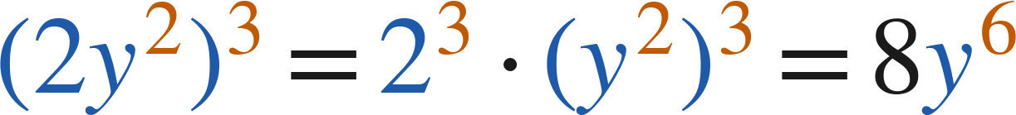
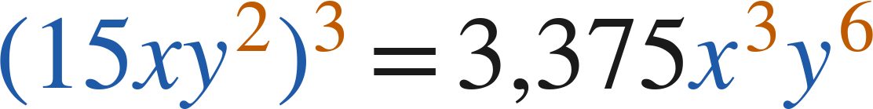
Notes
II. Power of a power, power of a product
Power of a power: multiply the exponents. Power of a product: raise every factor.
Grade 7 Accelerated · Unit 3 · Thread A · Day 1 — Exponent Laws with Variable Bases
5

Slide 6
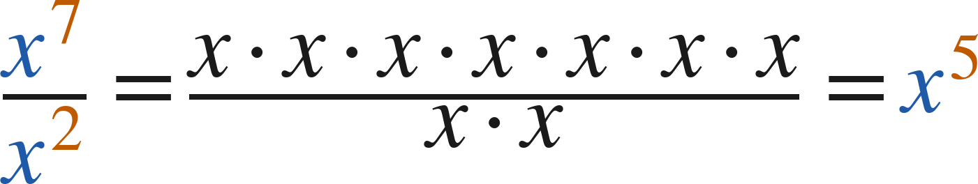
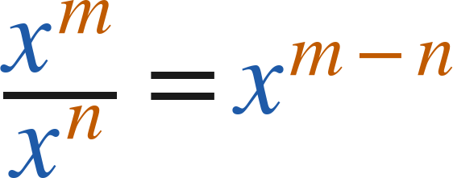
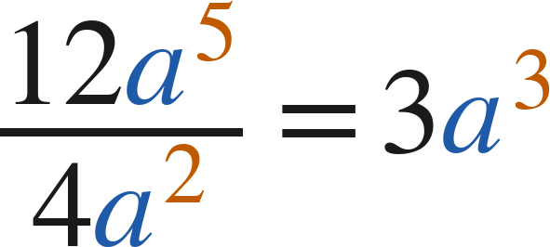
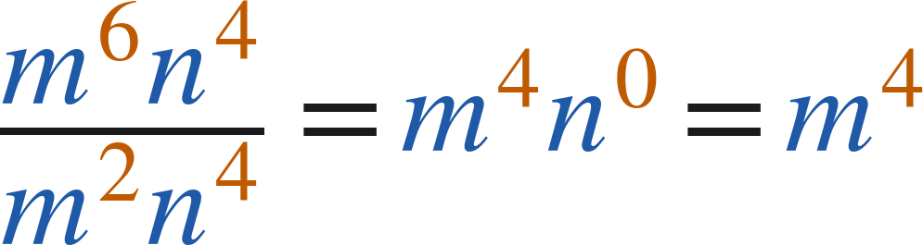
Notes
III. Quotient of powers — dividing monomials
Divide the coefficients. Subtract the exponents of like bases.
Grade 7 Accelerated · Unit 3 · Thread A · Day 1 — Exponent Laws with Variable Bases
6

Slide 7
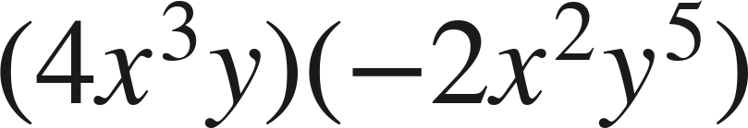
Example 1
Multiplying two monomials.
Write an equivalent expression as a single monomial.
Grade 7 Accelerated · Unit 3 · Thread A · Day 1 — Exponent Laws with Variable Bases
7

Slide 8
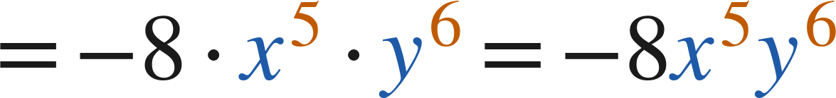
Example 1
Worked.
regroup: coefficients, x's, y's
multiply coefficients; add exponents
Answer: −8x⁵y⁶
Grade 7 Accelerated · Unit 3 · Thread A · Day 1 — Exponent Laws with Variable Bases
8

Slide 9
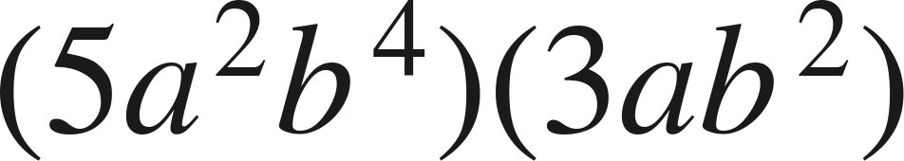
Your Turn
Same steps, your numbers. Boards up when done.
Grade 7 Accelerated · Unit 3 · Thread A · Day 1 — Exponent Laws with Variable Bases
9

Slide 10
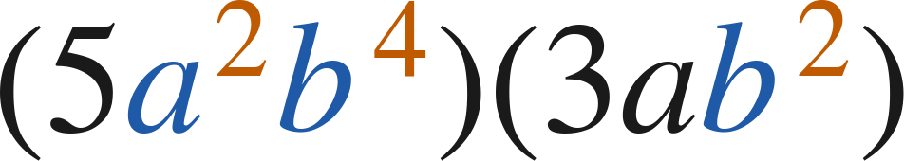
Your Turn
Answer.
5 · 3, a² · a¹, b⁴ · b²
Answer: 15a³b⁶
Grade 7 Accelerated · Unit 3 · Thread A · Day 1 — Exponent Laws with Variable Bases
10

Slide 11
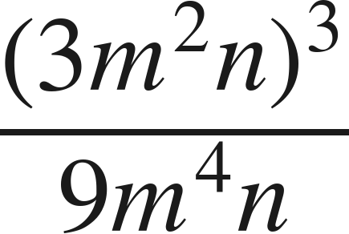
Example 2
A power of a product, then a quotient.
Write an equivalent expression as a single monomial.
Grade 7 Accelerated · Unit 3 · Thread A · Day 1 — Exponent Laws with Variable Bases
11

Slide 12
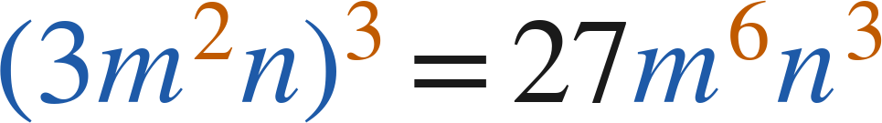
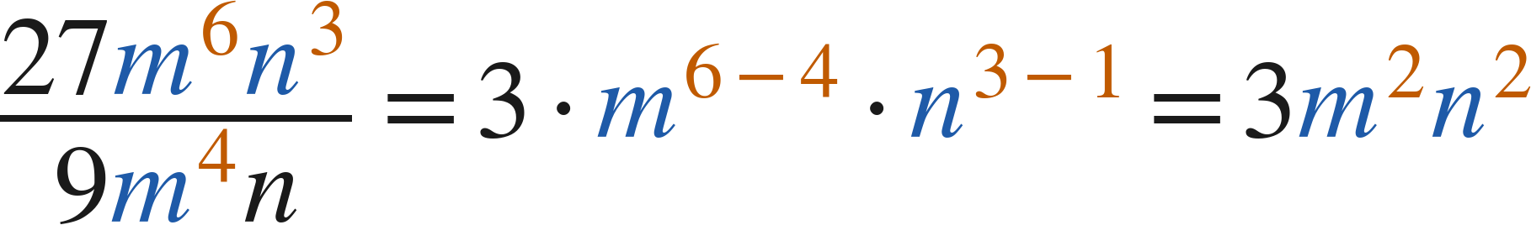
Example 2
Worked.
power of a product: raise all three factors
divide coefficients; subtract exponents
Answer: 3m²n²
Grade 7 Accelerated · Unit 3 · Thread A · Day 1 — Exponent Laws with Variable Bases
12

Slide 13
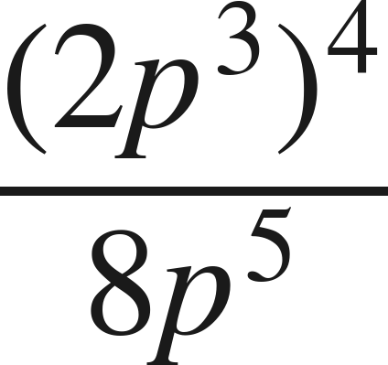
Your Turn
Same steps, your numbers. Boards up when done.
Grade 7 Accelerated · Unit 3 · Thread A · Day 1 — Exponent Laws with Variable Bases
13

Slide 14
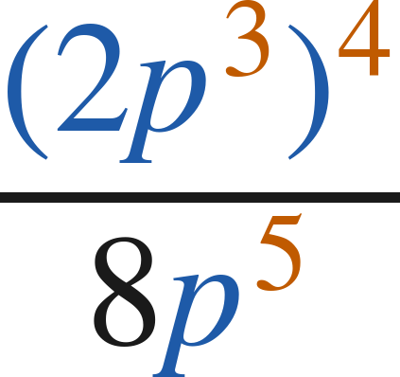
Your Turn
Answer.
16p¹² over 8p⁵
Answer: 2p⁷
Grade 7 Accelerated · Unit 3 · Thread A · Day 1 — Exponent Laws with Variable Bases
14

Slide 15
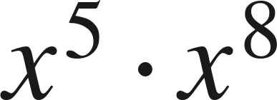
Whiteboards · Question 1 of 9
Boards up on three.
Answer it.
Write as a single power.
Grade 7 Accelerated · Unit 3 · Thread A · Day 1 — Exponent Laws with Variable Bases
15

Slide 16
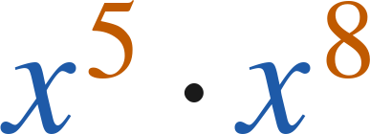
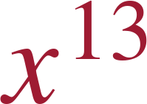
Whiteboards · Question 1 of 9
Answer.
like bases: add the exponents
Answer:
Grade 7 Accelerated · Unit 3 · Thread A · Day 1 — Exponent Laws with Variable Bases
16

Slide 17
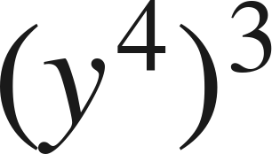
Whiteboards · Question 2 of 9
Boards up on three.
Answer it.
Write as a single power.
Grade 7 Accelerated · Unit 3 · Thread A · Day 1 — Exponent Laws with Variable Bases
17

Slide 18
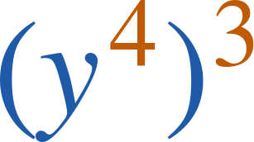

Whiteboards · Question 2 of 9
Answer.
power of a power: multiply
Answer:
Grade 7 Accelerated · Unit 3 · Thread A · Day 1 — Exponent Laws with Variable Bases
18

Slide 19
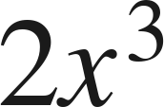
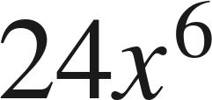
Whiteboards · Question 3 of 9
Boards up on three.
A cube has edge
centimeters.
Its surface area is
square centimeters.
Write the cube's volume as a single monomial.
Answer it.
Write as a single monomial.
Grade 7 Accelerated · Unit 3 · Thread A · Day 1 — Exponent Laws with Variable Bases
19

Slide 20
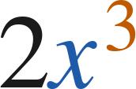
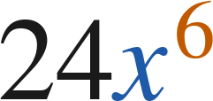
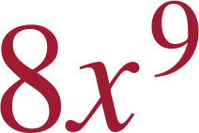
Whiteboards · Question 3 of 9
Answer.
A cube has edge
centimeters.
Its surface area is
square centimeters.
Write the cube's volume as a single monomial.
(2x³)³: raise the 2 as well
Answer:
Grade 7 Accelerated · Unit 3 · Thread A · Day 1 — Exponent Laws with Variable Bases
20

Slide 21
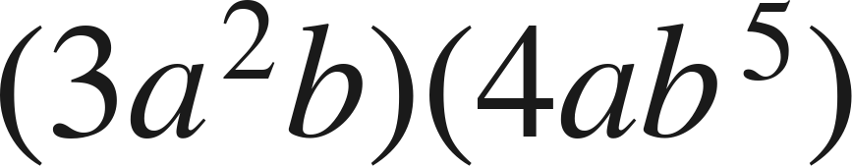
Whiteboards · Question 4 of 9
Boards up on three.
Answer it.
Write as a single monomial.
Grade 7 Accelerated · Unit 3 · Thread A · Day 1 — Exponent Laws with Variable Bases
21

Slide 22
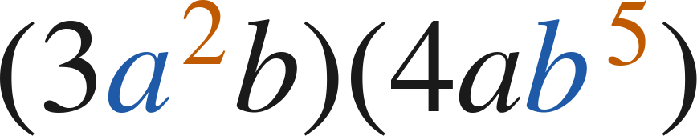
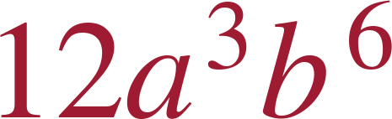
Whiteboards · Question 4 of 9
Answer.
3 · 4, a² · a, b · b⁵
Answer:
Grade 7 Accelerated · Unit 3 · Thread A · Day 1 — Exponent Laws with Variable Bases
22

Slide 23
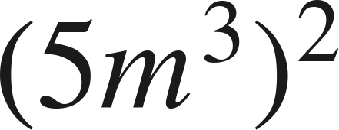
Whiteboards · Question 5 of 9
Boards up on three.
Which expression is equivalent?
A. 25m⁶
B. 10m⁶
C. 25m⁵
D. 5m⁶
Answer it.
Grade 7 Accelerated · Unit 3 · Thread A · Day 1 — Exponent Laws with Variable Bases
23

Slide 24
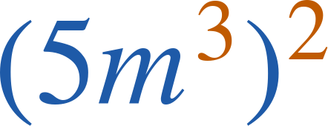
Whiteboards · Question 5 of 9
Answer.
Which expression is equivalent?
A. 25m⁶
B. 10m⁶
C. 25m⁵
D. 5m⁶
Answer: A — 25m⁶
Grade 7 Accelerated · Unit 3 · Thread A · Day 1 — Exponent Laws with Variable Bases
24

Slide 25
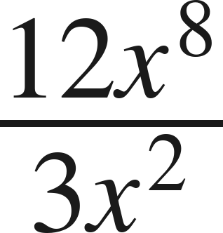
Whiteboards · Question 6 of 9
Boards up on three.
Which expression is equivalent?
A. 4x⁶
B. 4x⁴
C. 9x⁶
D. 4x¹⁰
Answer it.
Grade 7 Accelerated · Unit 3 · Thread A · Day 1 — Exponent Laws with Variable Bases
25

Slide 26
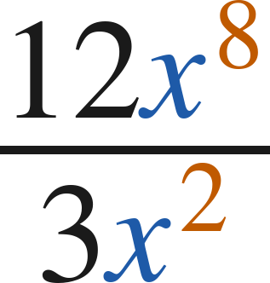
Whiteboards · Question 6 of 9
Answer.
Which expression is equivalent?
A. 4x⁶
B. 4x⁴
C. 9x⁶
D. 4x¹⁰
Answer: A — 4x⁶
Grade 7 Accelerated · Unit 3 · Thread A · Day 1 — Exponent Laws with Variable Bases
26

Slide 27
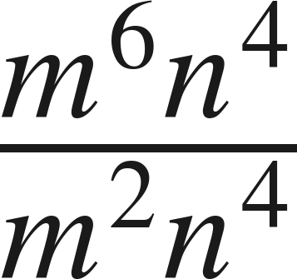
Whiteboards · Question 7 of 9
Boards up on three.
Answer it.
Write as a single monomial.
Grade 7 Accelerated · Unit 3 · Thread A · Day 1 — Exponent Laws with Variable Bases
27

Slide 28
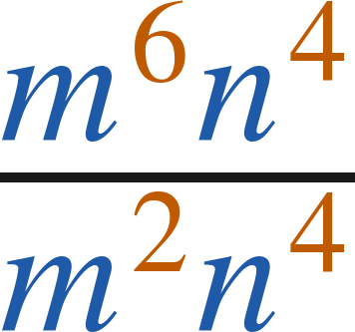

Whiteboards · Question 7 of 9
Answer.
m⁴ · n⁰, and n⁰ = 1
Answer:
Grade 7 Accelerated · Unit 3 · Thread A · Day 1 — Exponent Laws with Variable Bases
28

Slide 29

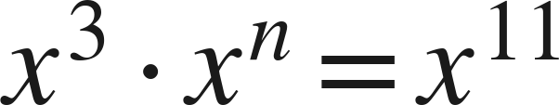
Whiteboards · Question 8 of 9
Boards up on three.
Find the value of
:
Answer it.
Which law applies?
Grade 7 Accelerated · Unit 3 · Thread A · Day 1 — Exponent Laws with Variable Bases
29

Slide 30
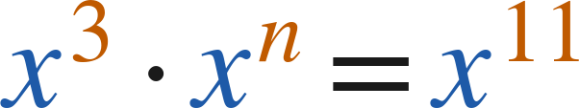
Whiteboards · Question 8 of 9
Answer.
Find the value of
:
3 + n = 11
Answer: n = 8
Grade 7 Accelerated · Unit 3 · Thread A · Day 1 — Exponent Laws with Variable Bases
30

Slide 31
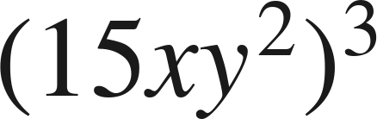
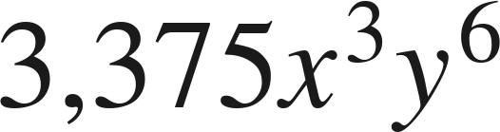
Whiteboards · Question 9 of 9
Take your time. Boards up when you have written it.
Rachel writes
as
.
Justina writes it as
. Who is correct? Explain.
Write your answer in sentences.
Say what each of them did.
Grade 7 Accelerated · Unit 3 · Thread A · Day 1 — Exponent Laws with Variable Bases
31

Slide 32
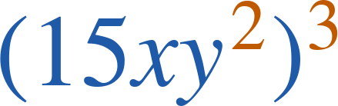
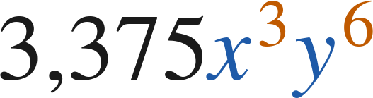
Whiteboards · Question 9 of 9
Answer.
Rachel writes
as
.
Justina writes it as
. Who is correct? Explain.
both — Justina's is Rachel's product, multiplied out
Answer: Both are correct; 15³ = 3,375, x · x · x = x³, and six y's make y⁶.
Grade 7 Accelerated · Unit 3 · Thread A · Day 1 — Exponent Laws with Variable Bases
32

Slide 33
Independent Set
Six questions. On your own, in silence.
1.
Six questions. Work down the page.
2.
Show the step that does the work, not just the answer.
3.
Silence until the six minutes are up.
Grade 7 Accelerated · Unit 3 · Thread A · Day 1 — Exponent Laws with Variable Bases
33

Slide 34
IXL
Last five minutes.
1.
Open IXL and start today's skills.
2.
Work on paper where the question needs work. The answer box does not show it.
3.
Every skill listed is required, to a SmartScore of 67. Due at the start of the next class.
Today's skills — all required
Multiply powers: variable bases — TR9
Powers of a power: variable bases — 2CU
Divide monomials with positive exponents — C8L
Grade 7 Accelerated · Unit 3 · Thread A · Day 1 — Exponent Laws with Variable Bases
34

